Slide 1
How to apologize Carely Villanueva and Sarah Hartley, 3/27

Slide 2
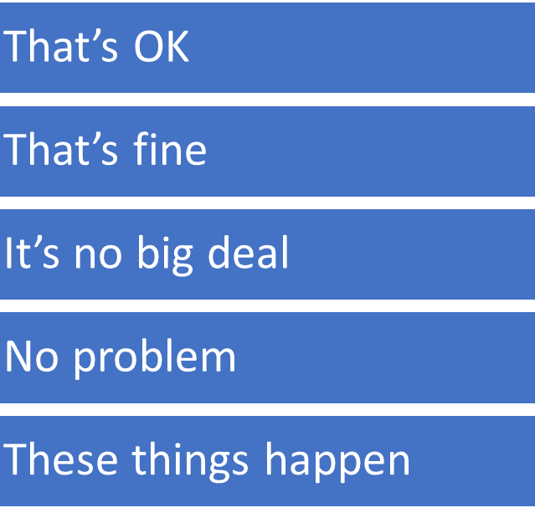
Informal Apologies
I’m sorry about + verb + (ing)
I’m so sorry …..
I really apologize for + noun or verb + (ing)
Sorry
Sorry for that
Please forgive me, I didn’t mean it

Slide 3
Formal Apologies
That’s quite all right
Please don’t worry about it.
I accept your apology.

Slide 4
Accepting responsibility
I promise it won’t happen again
She said she will be more careful next time
I will do my best not to repeat it
He will try as hard as he can to fix this
Please, be assured that this will never happen again

Slide 5
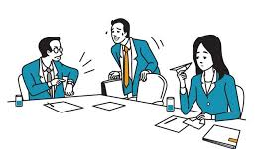
Examples
A: why are you late? We almost finished the meeting.
B: I’m terribly sorry. I had a car accident

Slide 6
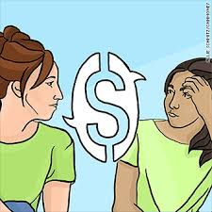
Examples
A: why didn’t you bring me my money?
B: I’m so sorry my friend. I really had to pay the rent. Next Thursday.

Slide 7
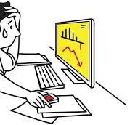
Examples
A: My sincere apologies for the mistake I made. Please be assured that this will never happen again.
B: That’s quite all right.

Slide 8
Your Turn

Slide 9
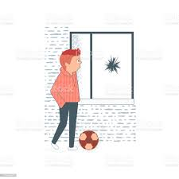
Situation 1
You are a child who has broken someone’s window

Slide 10
Situation 2
You have arrived late at a restaurant

Slide 11
Situation 3
You didn’t follow your boss’ instructions.

Slide 12
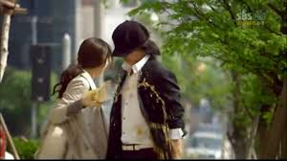
Situation 3
You have split someone’s drink.

Slide 13
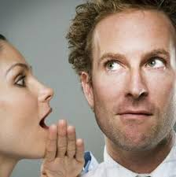
Situation 4
You didn’t hear someone.

Slide 14
Situation 5
Someone is speaking a language that you don’t know.

Slide 15
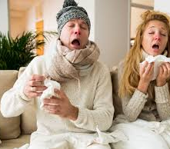
Situation 6
You have just blown your nose in front of someone.

Slide 16
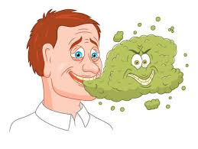
Situation 7
Your accidentally burp after a big meal.

