Slide 1
GECO, Class “B”
Accessing Healthcare
(going to the doctor)
October 17, 2020
Michèle, Teacher
Volunteers: Morgan, Reece, Teresa

Slide 2
Review
making appointments
polite requests
https://www.publicservicedegrees.org/resources/esl-ell-student-parent-teacher-resources/

Slide 3
Asking Politely: Review
Would instead of want:
I would like to make an appointment with Dr. Montoya, please.
Could instead of can:
Could I make an appointment to see Dr. Montoya, please?

Slide 4
Watch and Listen: Asking Politely
As we listen to a video and practice a dialogue during our lesson today, watch and listen for “would” and “could.”

Slide 5
What are we doing today? (Agenda)
learning vocabulary
talking with the doctor
https://www.publicservicedegrees.org/resources/esl-ell-student-parent-teacher-resources/

Slide 6
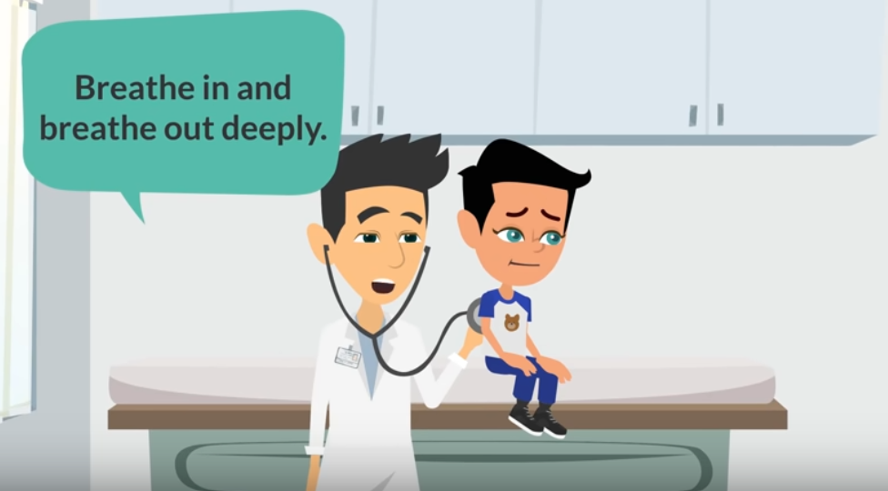
Talking With the Doctor (Video)
https://youtu.be/RLG8Nyve2vg
start 0:14
end 0:54
https://youtu.be/RLG8Nyve2vg

Slide 7
Doctor Visit…Let’s Chat!
How do you decide if you need to go to the doctor?
What kinds of things do you take with you to the doctor?
What information will the doctor need from you?

Slide 8
Doctor Visit: Instructions!
We’ll look at some questions about doctor appointments and write our answers.
We’ll show you what to do in the Breakout Rooms.
In the Breakout Rooms, discuss your questions with each other.
One partner asks a question. The other answers.
Switch and Repeat!
Move on to the next question!

Slide 9
Doctor Visit: 3-Minute Writing
TAKE A
PHOTO OF THIS SLIDE!!
Answer the following questions:
Why did you go to the doctor?
What were your symptoms?
What questions did they ask you?
What questions did you ask them?
What do you want to know how to say that will help next time?
KEEP YOUR PAPER FOR THE BREAKOUT ROOMS!

Slide 10
Doctor Visit: Model and Next Steps
Model: Discussing our answers!
What are you going to do next?
Bring your papers with you into the breakout rooms.
After you share, you can ask any of the volunteers for help with phrasing questions or vocabulary. You can ask each other questions.

Slide 11
Doctor Visit: What’s Your Story?
TAKE A
PHOTO OF THIS SLIDE!
Why did you go to the doctor?
What were your symptoms?
What questions did they ask you?
What questions did you ask them?
What do you want to know how to say that will help next time?
TAKE YOUR PAPER WITH YOU TO THE BREAKOUT ROOMS!

Slide 12
Share Your Story!
CLASS
DISCUSSION
Why did you go to the doctor?
What were your symptoms?
What questions did they ask you?
What questions did you ask them?
What do you want to know how to say that will help next time?

Slide 13
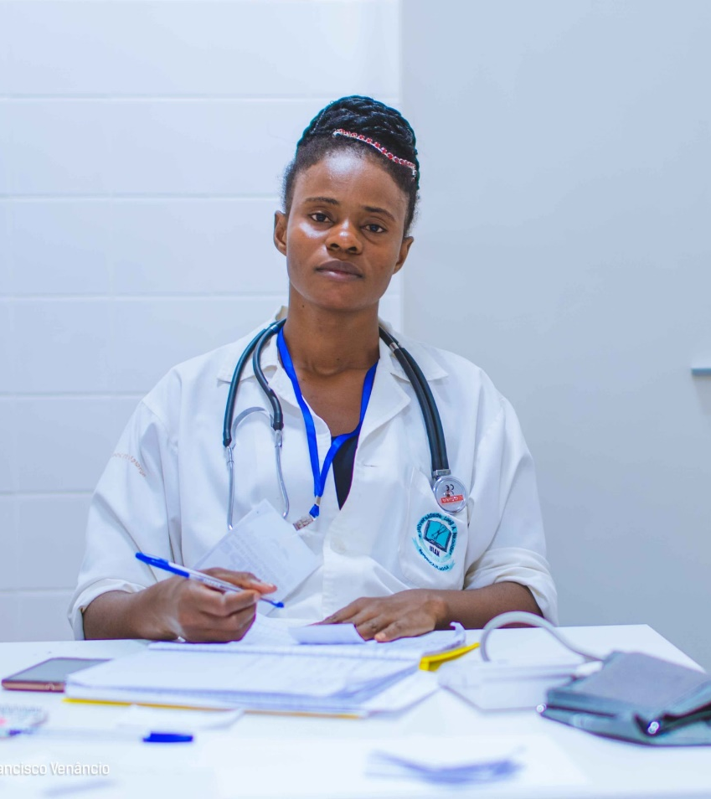
Vocabulary
See the word.
Say it.
Define the word.
See the definition.
Use in a sentence!
https://unsplash.com/photos/M4Xloxsg0Gw

Slide 14
Vocabulary
doctor
a person who is trained and licensed to treat sick and injured people
(also called a physician)
https://unsplash.com/photos/M4Xloxsg0Gw

Slide 15
Vocabulary
examination
a close and careful study of
someone or something
to find signs
of illness or injury
https://youtu.be/RLG8Nyve2vg

Slide 16
Vocabulary
stethoscope
an instrument that is used for listening to someone's heart or lungs
https://unsplash.com/photos/IJ0KiXl4uys

Slide 17
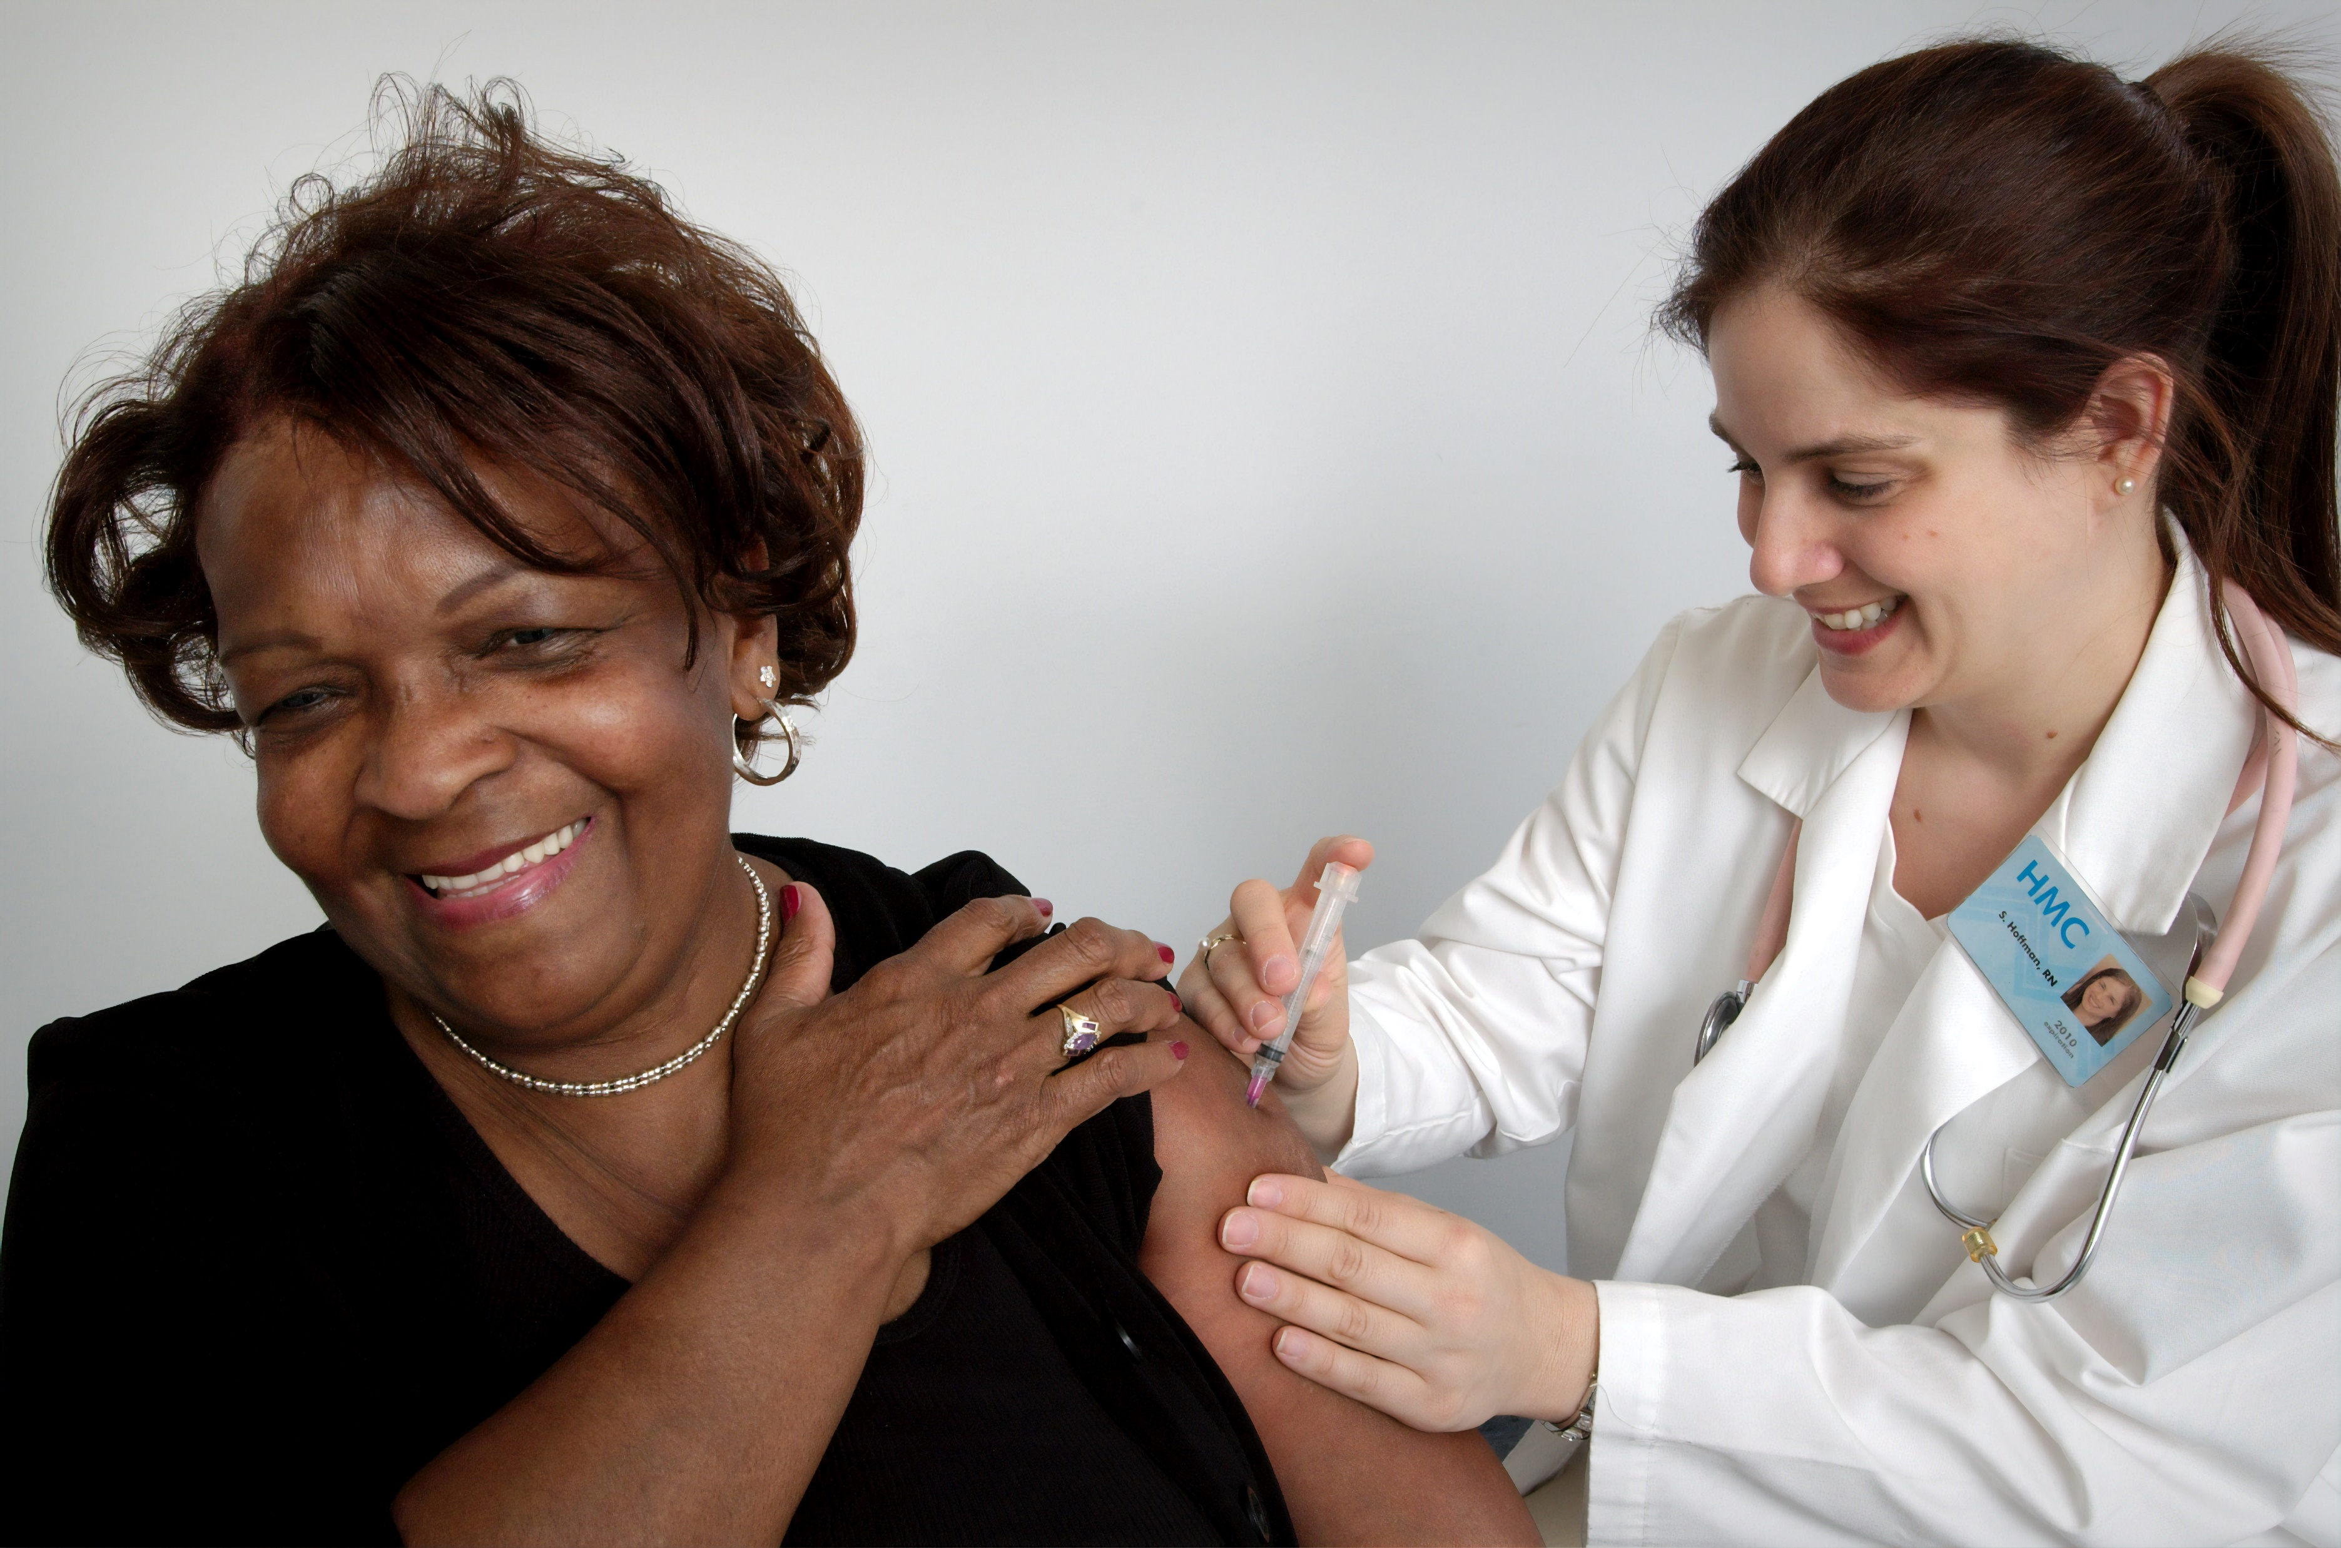
Vocabulary
nurse
a person who is trained
to care for sick or injured
people and who usually
works in a hospital or doctor's office
https://unsplash.com/photos/d3fe9qJDqaI

Slide 18
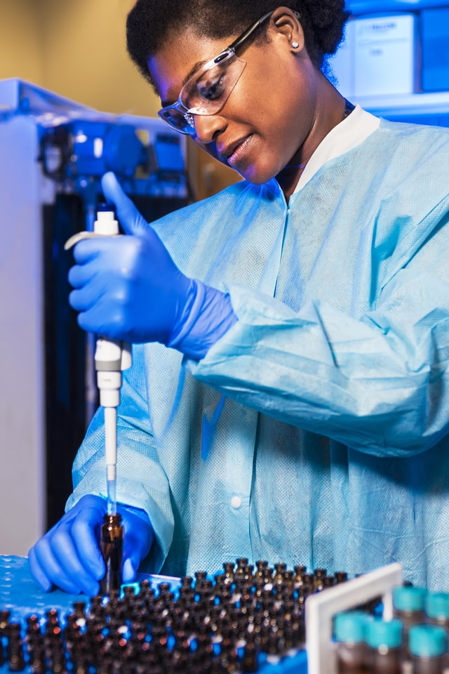
Vocabulary
medical technician
a person who uses machines and science-based methods in the field of medicine
Example: X-ray technician
https://unsplash.com/photos/_N7I1JyPYJw

Slide 19
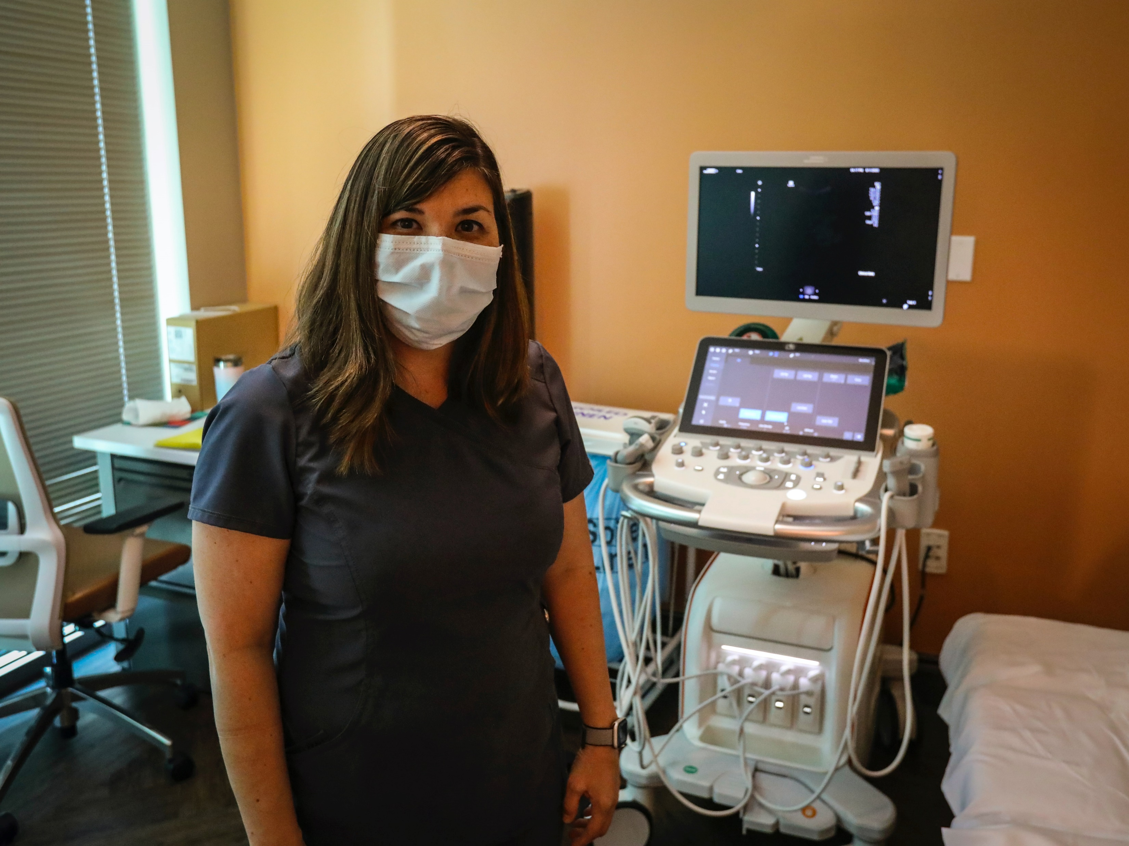
Vocabulary
https://unsplash.com/photos/d3fe9qJDqaI
ultrasound
a way to take photographs inside the body by using sound waves
an image that is made through this type of photography

Slide 20
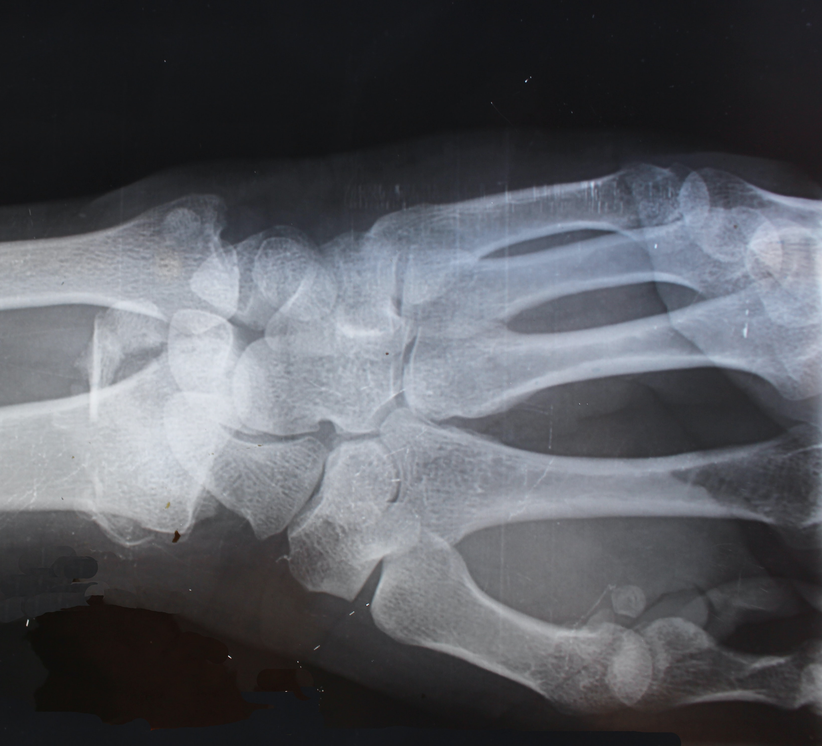
Vocabulary
X-ray
a special way of taking photos inside the body for medical purposes
the resulting photo from using this method of photography
https://unsplash.com/photos/_GpJpHnyCSw

Slide 21
Vocabulary
EKG
a machine that detects and records the heart’s electrical activity
the printed recording that an EKG machine makes

Slide 22
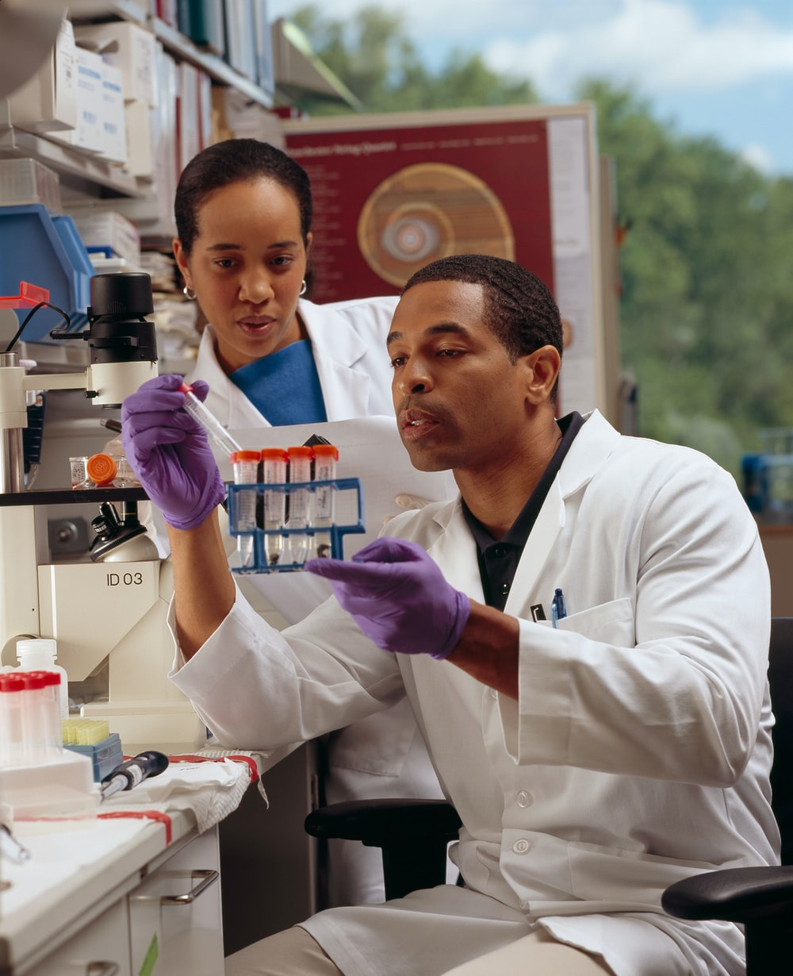
Vocabulary
Blood work
tests that are run from a patient blood sample
https://unsplash.com/photos/PP5nO5gcLdA

Slide 23
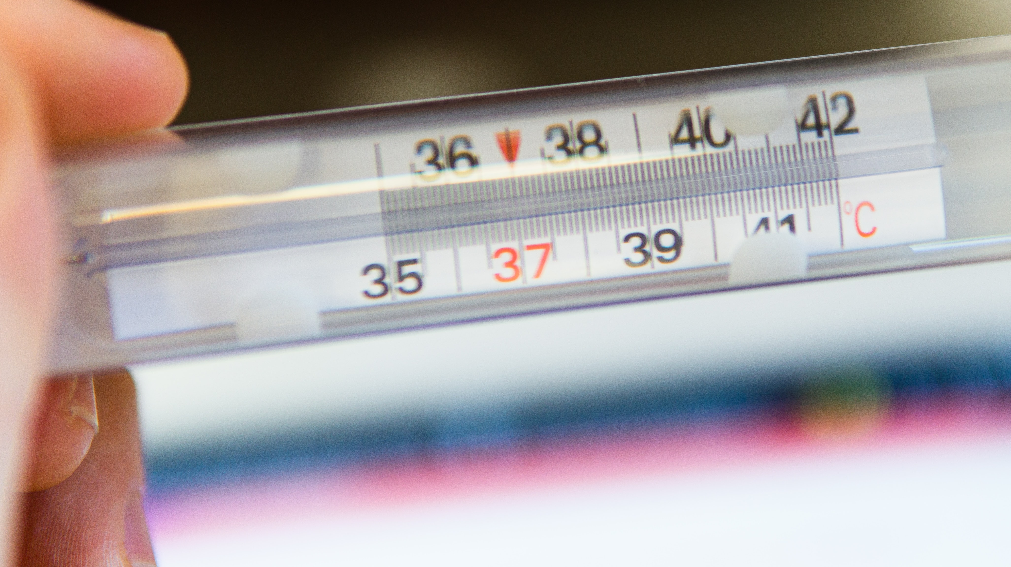
Vocabulary
symptom
a change in the body or mind which indicates that a disease is present

Slide 24
Talking With the Doctor (Intro)
When we are sick and don’t know why, or need some help, we can go to the doctor.
There are many different types of doctors:
general physician
specialist

Slide 25
Talking With the Doctor (Preview)
https://unsplash.com/photos/M4Xloxsg0Gw
Today we’ll look at…
How to tell the doctor what’s wrong
How to answer the doctor’s questions
How to ask the doctor questions

Slide 26
Talking With the Doctor (Coming Up)
https://unsplash.com/photos/M4Xloxsg0Gw
Next we’ll watch a video of a doctor’s appointment.
What are some things that we’ll see in this video?

Slide 27
Talking With the Doctor (Video)
https://youtu.be/RLG8Nyve2vg
start 0:14
end 0:54
In the video and dialogue,
listen and watch
for these vocabulary words!
https://youtu.be/RLG8Nyve2vg

Slide 28
Talking With the Doctor (Review)
https://unsplash.com/photos/M4Xloxsg0Gw
Who is in the video?
What happened in the video?
In the video, how did the mother tell the doctor what was wrong with her son?
“My son has a fever, doctor!”

Slide 29
Talking With the Doctor (Video Review)
In the video, what questions did the doctor ask?
How did the mother answer?
…see the next slide!

Slide 30
Talking With the Doctor (Video Review)
Doctor’s Question
Hello, what’s wrong?
Mother’s Answer
My son has a fever, doctor!

Slide 31
Talking With the Doctor (Video Review)
In the video, the mother didn’t ask the doctor questions. What questions could she have asked? Please share your ideas!
Does my son need to eat food with the medicine?
What do I do if his fever gets worse?
Should I bring him back to see you in a few days?

Slide 32
Talking With the Doctor (Dialogue)
Preparing for Breakout Rooms…
We’ll practice a typical dialogue at a doctor’s appointment!
If you finish early:
…ask each other questions about it!
…find medical vocabulary words that you know!

Slide 33
Talking With the Doctor (Dialogue)
Preparing for Breakout Rooms…
Watch and listen for medical vocabulary terms.
Model Reading: English for Medical Purposes – A Physical Examination

Slide 34
Your Turn!
TAKE A PHOTO OF THIS SLIDE!!
Break into pairs or a trio
Practice the dialogue together
Take turns playing roles
Copy and paste the dialogue in Chat. or
Download the document from Chat.
If you can’t get the dialogue, make one up based on the video! Write it down to share with the class.

Slide 35
Read Aloud!
CLASS
DISCUSSION
Who would like to read the dialogue for the class?
Did anyone write a dialogue that they would like to share with the class?

Slide 36
Review of Today’s Agenda
learning new vocabulary
talking with the doctor

Slide 37
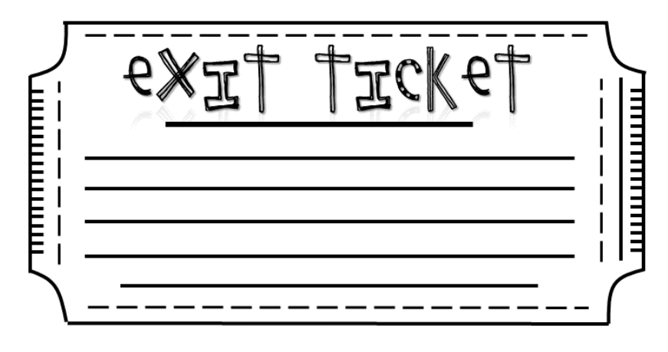
Please let us know...
something you learned today
anything you didn’t understand
Then, take a photo of your answers and send it to:
mpointel@zagmail.gonzaga.edu
Visit our GECO web site:
https://gecoenglish.weebly.com/
So glad you could come!
See you next week!

Slide 38
References
Beare, K.English for Medical Purposes - Making a Doctor's Appointment. YouTube. https://www.thoughtco.com/making-a-
doctors-appointment-1210351
Easy English.Health and Ilnesses Conversation. YouTube.
https://youtu.be/RLG8Nyve2vg
Merriam-Webster Learner's Dictionary. Merriam-Webster Learner’s
Dictionary. https://learnersdictionary.com/

Slide 39
Extension Activity: What’s the Word?
Vocabulary Game
Share the screen to show the activity sheet.
Go through vocabulary words on the sheet; have students write the word on a sheet of paper.
Call on students for the answer; give the answer if no one knows it.

