Slide 1
Requests The power of words
Sara Hanson-Lynn
Pragmatics, Chapter 3

Slide 2
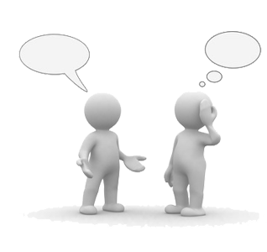
Warm-up
To request: to ask for an action, object, information, or permission.
How do you make requests in English? Is it the same or different in your first language?
(F) Can I… (B) May I… (B) Would you like to…
(B) Could you… (F) Let me borrow your phone. Pass me the…
(F) Do you want…
How do you make a request to your boss? Your friend?
What changes how you make requests?
Different levels of relationship, respect, maybe a stranger, location, word choice…

Slide 3
ONE: Types of requests
How are these requests different?
Example one
“Close the window.”
-DIRECT IMPERATIVE
“Would you close the window?”
-INDIRECT QUESTION FORM
“It’s cold in here.”
-INDIRECT HINT

Slide 4
Categorize the requests.
Situation: I can’t go to class tomorrow because I have a doctor’s appointment.
Example two
“Take notes for me.”
“I won’t have notes from that class.”
“Could you send me the class notes?”
Direct | Indirect | Hint

Slide 5
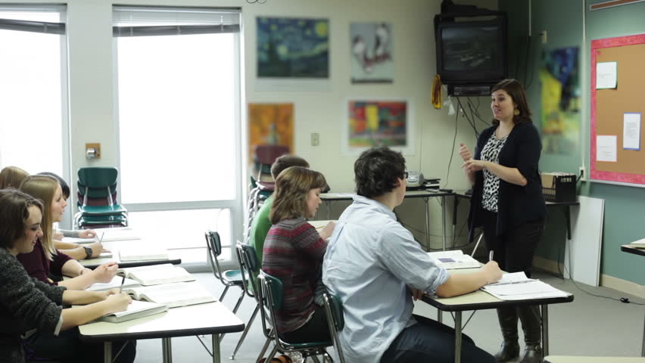
TWO: Making requests
Situation: In class, the teacher wants me to read from the textbook, but I forgot it at home. A classmate next to me has their textbook. I need to borrow it.
How can I ask?
Direct:
Indirect:
Hint:

Slide 6
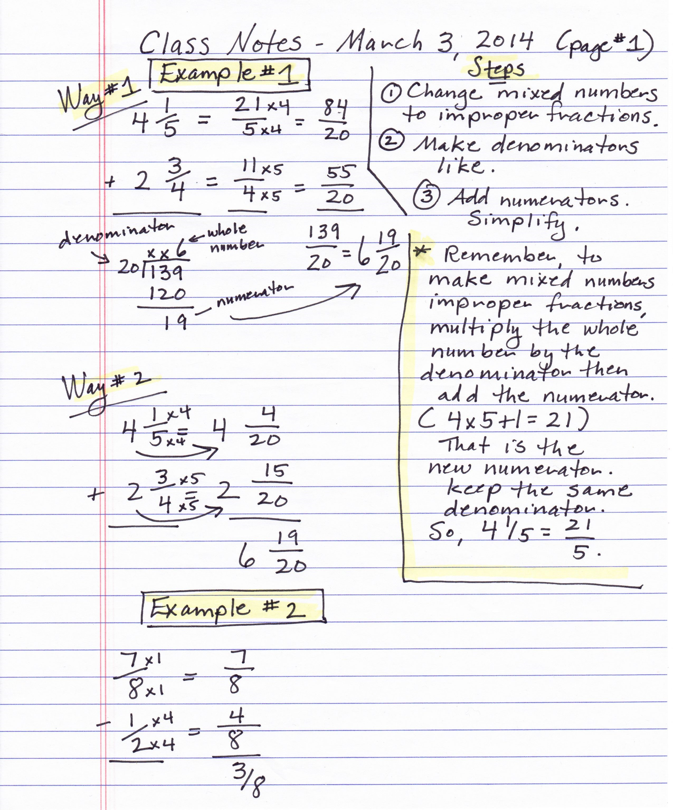
Context
“Take notes for me.”
“I won’t have notes from that class.”
“Could you send me the class notes?”
Which request would you use with a friend? With the teacher?
Do the requests need to be changed?

Slide 7
Context
How polite must I be? Consider…
Relationship
Intimate ------------------------------------------- Distant
Status
High ------------------------------------------------ Low
Formality
Formal ------------------------------------------- Informal

Slide 8
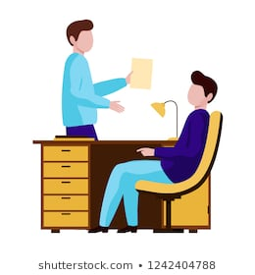
THREE: Softening requests
*Cultural tip
In English, I want to soften the request if:
It is a big request (e.g. “Can I have a raise?”)
I don’t know the person very well (stranger, boss)
They have higher status than me (boss, parents)
I want to sound polite

Slide 9
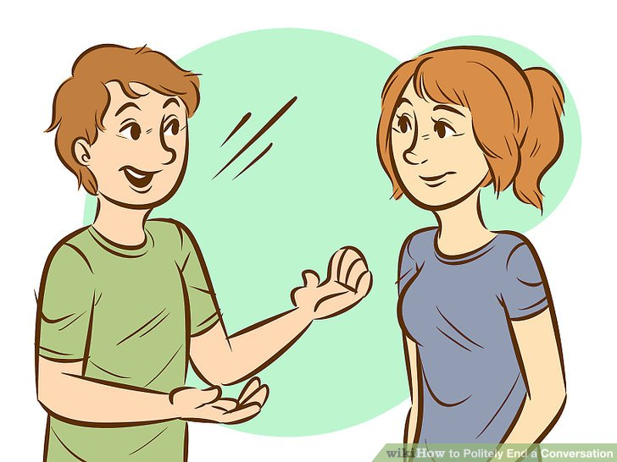
Softening requests
Prepare them (Can I ask you something?)
Get precommitment (Could you do me a favor?)
Give a reason (I was sick yesterday…)
Acknowledge them (I know you are busy, but…)
Promise reward (…I’ll do it next time.)
Minimize imposition (…but only if you have time.)

Slide 10
FOUR: Identify softeners
What is the request? What expressions soften the request? What type of softeners are they?
Student to teacher:
1. I know class is over, but I only have one more question on the test. Could I please have five more minutes? Unless you have to leave right now.
Friend to friend:
2. Could you do me a favor? I’ve been applying to jobs, and I was wondering if I could use you as a reference.You’re an amazing writer. We’ve worked together, so I think you know me well, and I will be a reference for you if you ever need!
Prepare them
Get precommitment
Give a reason
Acknowledge them
Promise reward
Minimize imposition

Slide 11
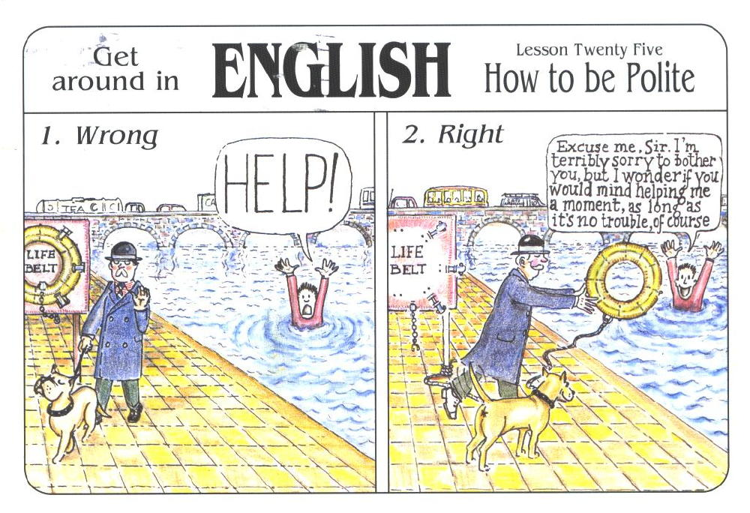
Identify the softeners
Prepare them
“I’m terribly sorry to bother you…”
Get precommitment
Give a reason
Acknowledge them
Promise reward
Minimize imposition
“as long as it’s no trouble”

Slide 12
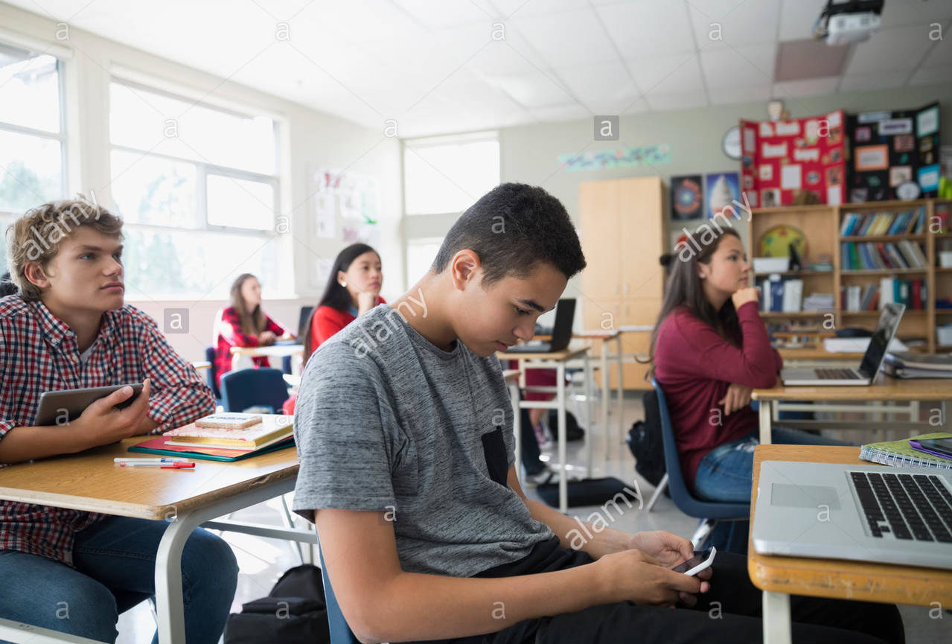
Soften the requests
Student to teacher:
Situation #1: You did the homework but forgot it at home. You want to bring it next class but need the teacher’s permission.
“I’m sorry, I did my homework but I forgot to bring it. Can I bring my homework next class? If you have time to grade it then. Unless you’re too busy next class.”
Teacher to student:
Situation #2: A student is texting in your class. You want the student to put the phone away.
Friend to friend:
Situation #3: You want to go to a party but can’t get there by bus. You want your friend (who is also invited) to drive you to the party.

Slide 13
References
Eslami, Z. R., McLeod, K. D. (2010). It’s 8 O’clock in the Morning—Are You Watching Television? Teaching Indirect Requests. In Pragmatics: Teaching Speech Acts. (pp19-28). Mattoon, IL: United Graphics, Inc.
Holmes, J. (2013). An Introduction to Sociolinguistics. Abingdon, Oxon: Routledge.

