Slide 1
Requests The power of words
Sara Hanson-Lynn
Pragmatics, Chapter 3

Slide 2
Warm-up
To request: to ask for an action, object, information, or permission.
How do you make requests in English? Is it the same or different in your first language?
How do you make a request to your boss? Your friend?
What changes how you make requests?

Slide 3
ONE: Types of requests
How are these requests different?
Example one
“Close the window.”
-DIRECT IMPERATIVE
“Would you close the window?”
-INDIRECT QUESTION FORM
“It’s cold in here.”
-INDIRECT HINT

Slide 4
Categorize the requests.
Situation: I can’t go to class tomorrow because I have a doctor’s appointment.
Example two
“Take notes for me.”
“I won’t have notes from that class.”
“Could you send me the class notes?”
Direct | Indirect | Hint
“Take notes for me” | “Could you send me the class notes?” | “I won’t have notes from that class.”

Slide 5
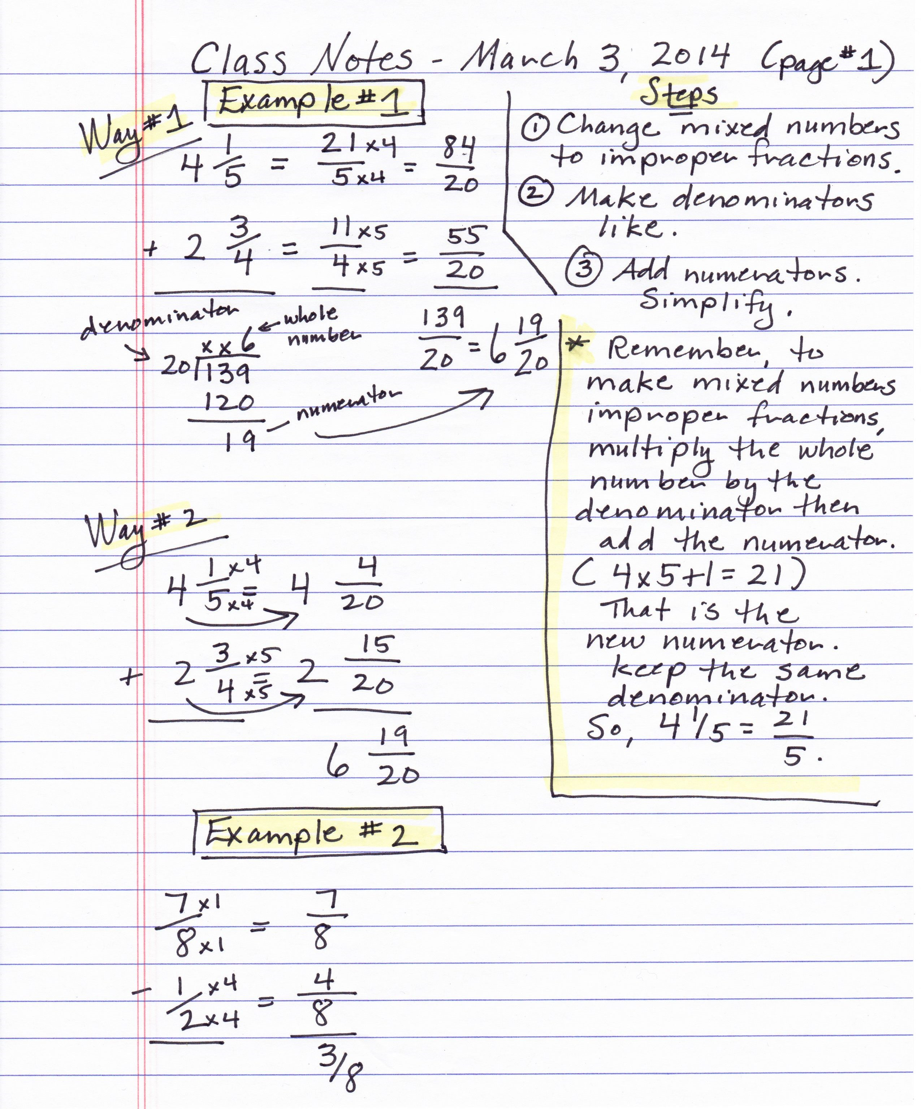
Context
“Take notes for me.”
“I won’t have notes from that class.”
“Could you send me the class notes?”
Which request would you use with a friend? With the teacher?
Do the requests need to be changed?

Slide 6
Context
How polite must I be? Consider…
Relationship
Intimate ------------------------------------------- Distant
Status
High ------------------------------------------------ Low
Formality
Formal ------------------------------------------- Informal

Slide 7
References
Eslami, Z. R., McLeod, K. D. (2010). It’s 8 O’clock in the Morning—Are You Watching Television? Teaching Indirect Requests. In Pragmatics: Teaching Speech Acts. (pp19-28). Mattoon, IL: United Graphics, Inc.
Holmes, J. (2013). An Introduction to Sociolinguistics. Abingdon, Oxon: Routledge.

