Slide 1
Requests The power of words
Sara Hanson-Lynn
Pragmatics, Chapter 3

Slide 2
WELCOME BACK! IT’S WEEK 3! 😊
Type your high of the week into the chat.
High: something that went good/something that you enjoyed this week

Slide 3
Warm up Match the Sentence to the Correct Form
To request: to ask for an action, object, information, or permission.
Turn the lights on. __a____
Um, I can’t see. ____c____
Can you please turn the lights on?___b__
Direct Imperative
Indirect Question Form
Indirect Hint
Which option is the most polite?
Notes:
Most polite is called softening the request

Slide 4
THREE: Softening requests
*Cultural tip
In English, I want to soften the request if:
It is a big request
I don’t know the person very well
They have higher status than me
I want to sound polite

Slide 5
How do we make our requests more formal or polite?
“Come here.”
“Turn down the music”
“I only need to talk to you for five minutes, OK?”
“Um, could you please come here?”
“Could you turn the music down just a little bit?”
“I need to talk to you.”
What words are used to soften the requests?
Notes:
Notice how the polite sentence is way longer

Slide 6
FIVE: Words used to soften requests
In addition to phrases, we can use words like:
Please, just, um, only, OK
For example:
“Um, could you please come here?”
“Could you turn the music down just a little bit?”
“I only need to talk to you for five minutes, OK?”

Slide 7
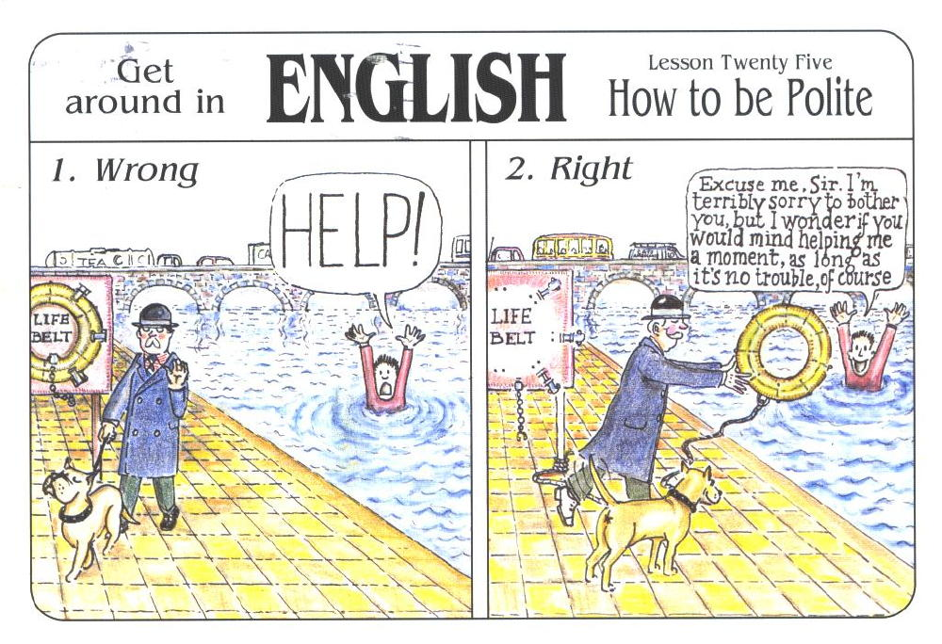

Slide 8
How do you respond?
Situation #1 : Your child’s teacher wants to meet with you. She tells you a time to meet, but you are busy. How do you ask to meet at a different time?
Direct: ____I can’t meet with you at that time. Meet me at 2pm instead.______________
Indirect: _____I’m busy at that time. Could we meet at another time?_________
Hint: ____I think I have something at that time.________________________________________

Slide 9
How do you respond?
Situation #2: Your child is sick and cannot go to school. How do you ask the teacher to send the missed assignments?
Direct: _______Send the assignments to my email.__________________________________
Indirect: _______Could you send the assignments to my email, please?___________________
Hint: ________I don’t want my child to miss the assignment._____________________________
Situation#3: Create your own!
Direct: ________________________________________________________________________
Indirect: _______________________________________________________________________
Hint: _________________________________________________________________________

Slide 10
Create your own situation!
Go into breakout rooms to create your own situation for another group to respond to.
Where does the situation take place?
What is happening?
Who are you talking to?

Slide 11
CREATE YOUR OWN
How do you respond? Indirect, hint, or direct
Situation #1: You have a job interview, but you can’t arrive. So, you want to know if the boss can interview you at a different day.
Indirect: Something unexpected happened, so I would like to know if you could change the interview for another day, please?
Situation#2: You are in your house and the wifi service shut down. So, you go to your neighbor and ask for their wifi password. How could you ask for the wifi password?
Hint: Hey neighbor! I’m frustrated because I have work that I need to do but my wifi is dead.
Indirect: My wifi turned off, could I please use your internet for a little bit?

Slide 12
CREATE YOUR OWN
How do you respond? Indirect, hint, or direct
Situation #3: Your kid told you that John is bullying him. So, you need to ask the teacher for a meeting involving the principal and John’s parents.
Indirect: My kid said that John is bullying him. Could I have a meeting with the principal and his parents, please?
Direct: I want a meeting with the principal and John’s parents.

Slide 13
SEVEN: Homework
Collect five samples of requests in English. The requests can come from TV, movies, music, or real conversations.
Next class, we will share our examples.

Slide 14
References
Eslami, Z. R., McLeod, K. D. (2010). It’s 8 O’clock in the Morning—Are You Watching Television? Teaching Indirect Requests. In Pragmatics: Teaching Speech Acts. (pp19-28). Mattoon, IL: United Graphics, Inc.
Holmes, J. (2013). An Introduction to Sociolinguistics. Abingdon, Oxon: Routledge.

