Slide 1
Resume Building
Objectives:
Students will learn able to identify, write about, and apply their skills when looking for a job.

Slide 2
What did You do? What do you do now? What do you want to do?
Recall…

Slide 3
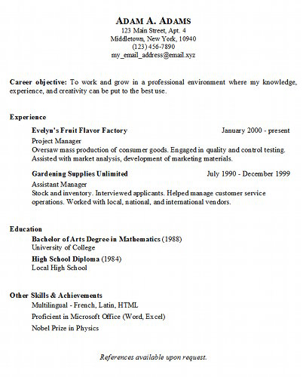
What is a Resume?
1
2
short description of your former employment, talents, and skills.
1-2 pages
Past tense*
There are five (5) basic Parts to a Resume
Your Information
Your Career Objective *
Your Experience
Education
Skills and Achievements
3
4
5

Slide 4
Your Information
1
Should Include
Name
Address
Phone number
Email address
Should NOT include
Age
Eye color
Height

Slide 5
Career Objective
To Verb + Verb in a adjective noun where my skill , skill, and skill can be put to the best use.
Implement
Carry out
Initiate
Facilitate
Manage
Learning Moment: Career Objective should be in the present tense.
2

Slide 6
Experience
3
At least three (3) jobs you have worked
Past tense verbs

Slide 7
Education
4
Highest level of education
Include year of graduation
Key vocabulary: Bachelor, Diploma, Degree

Slide 8
Skills and Achievements
5
The languages you speak
Certifications
What are you good at?
What do you like to do?

