Slide 1
GECO, Class “B”
October 10, 2020
Michèle Pointel, Teacher
Volunteers: Katie, Morgan, Teresa

Slide 2
Unit Topic
Accessing Healthcare
(going to the doctor)

Slide 3
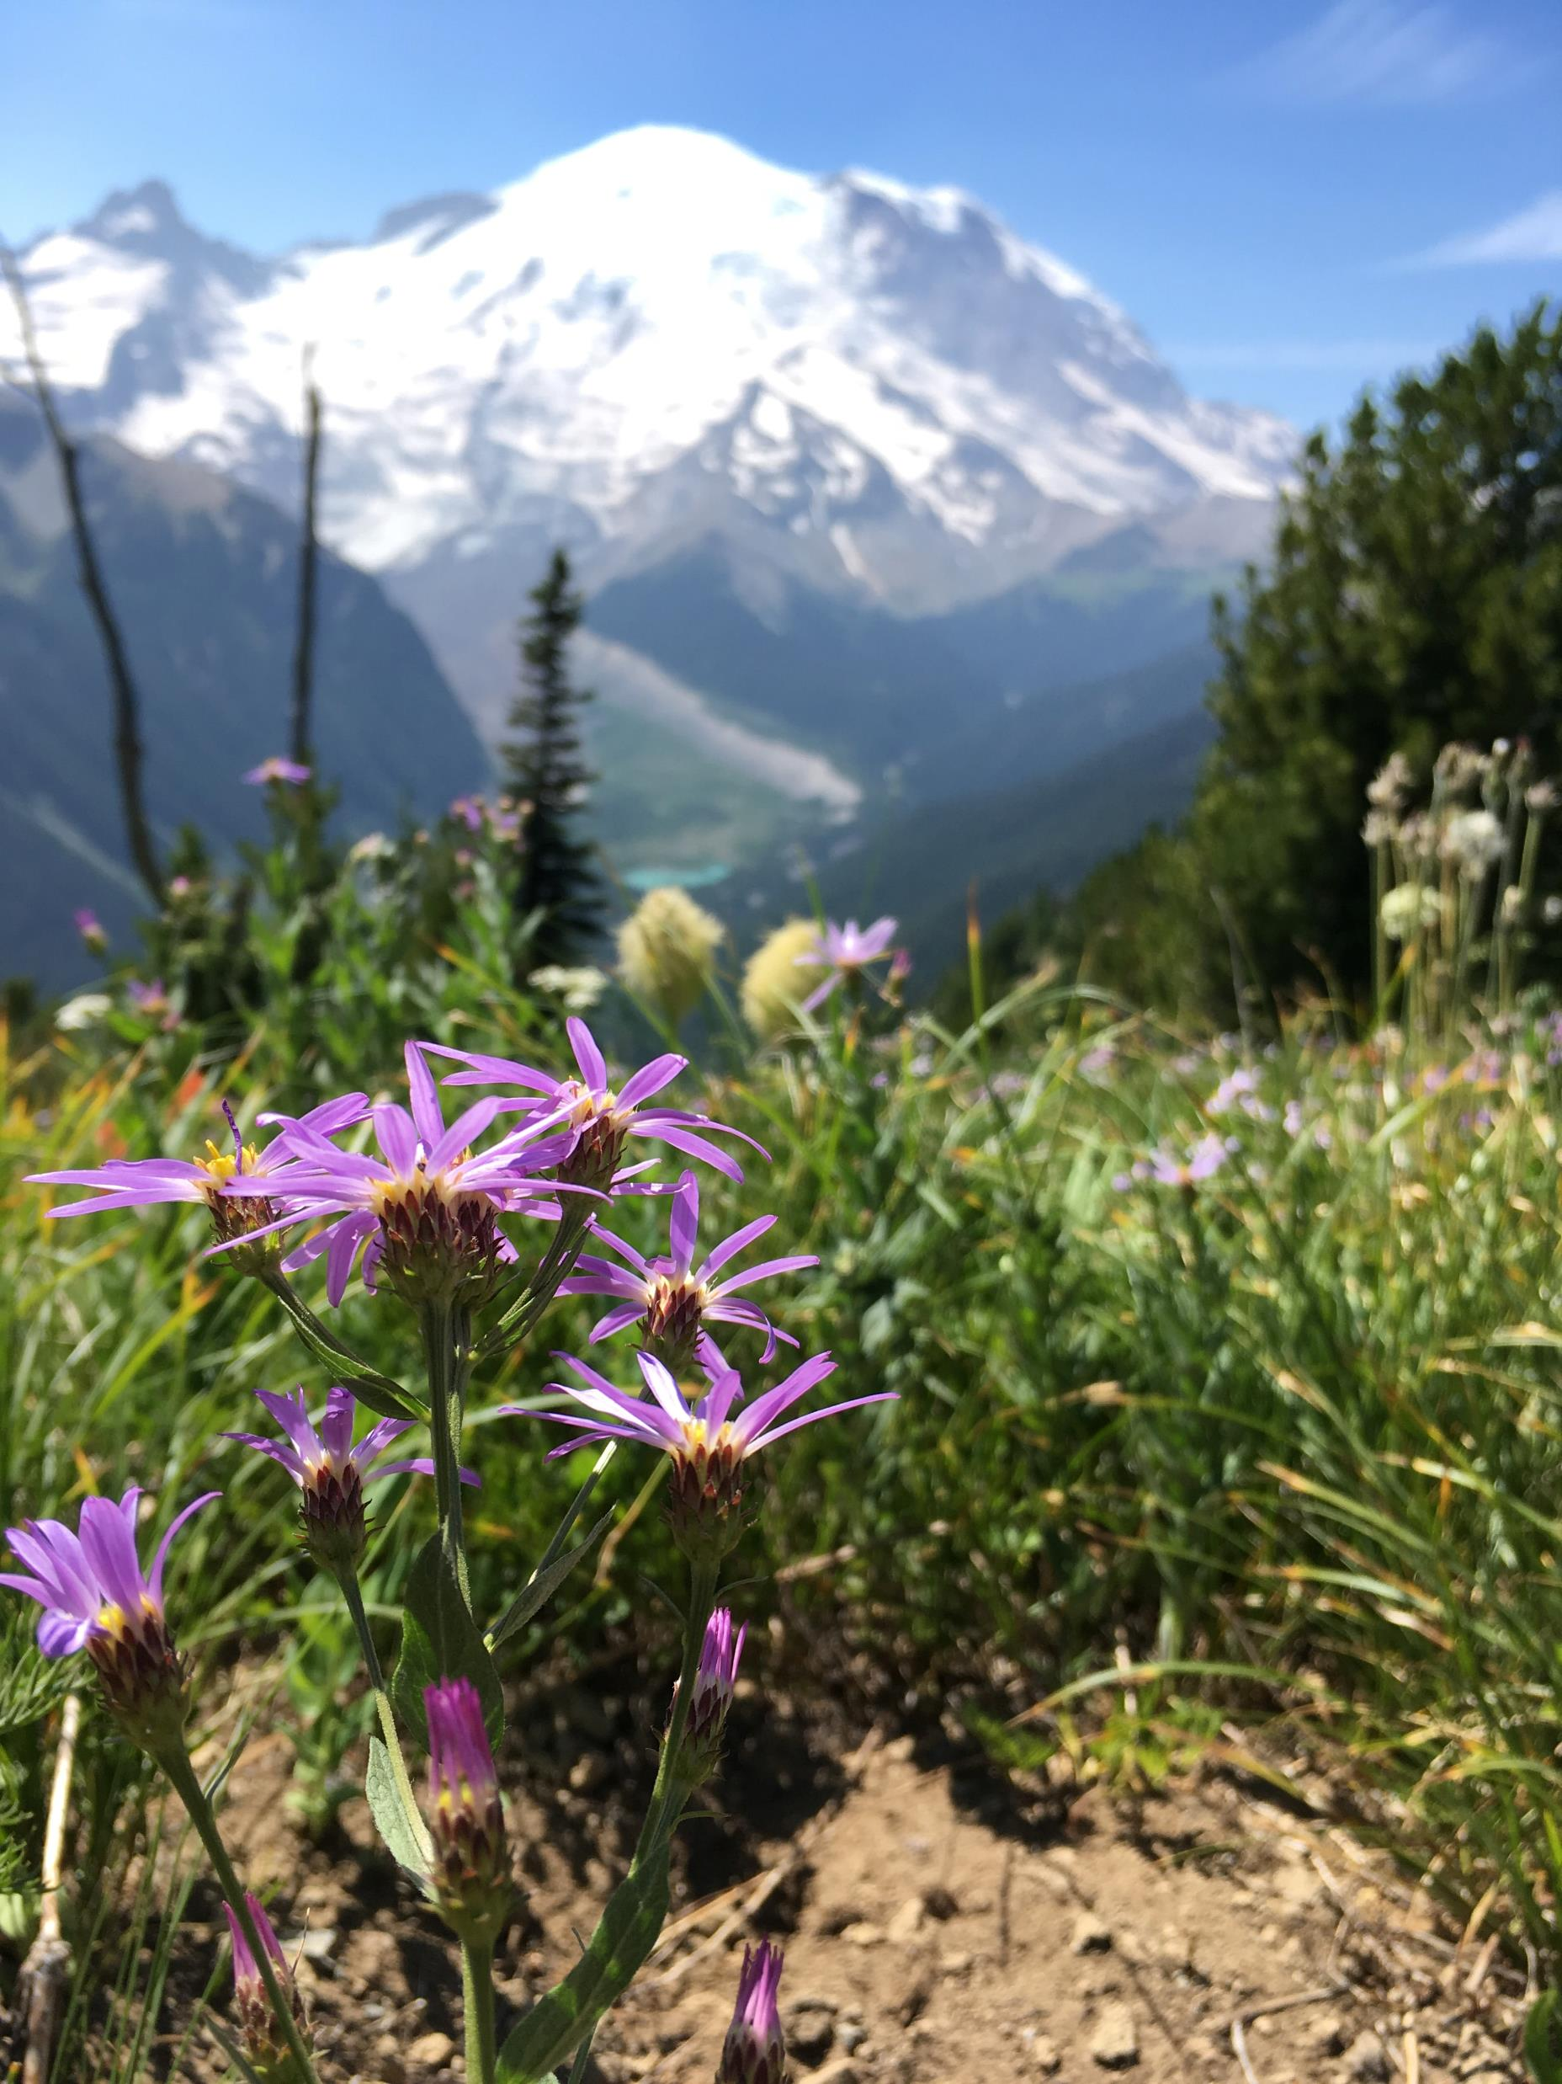
Welcome from Our Volunteers!!
Katie
Morgan
Teresa

Slide 4
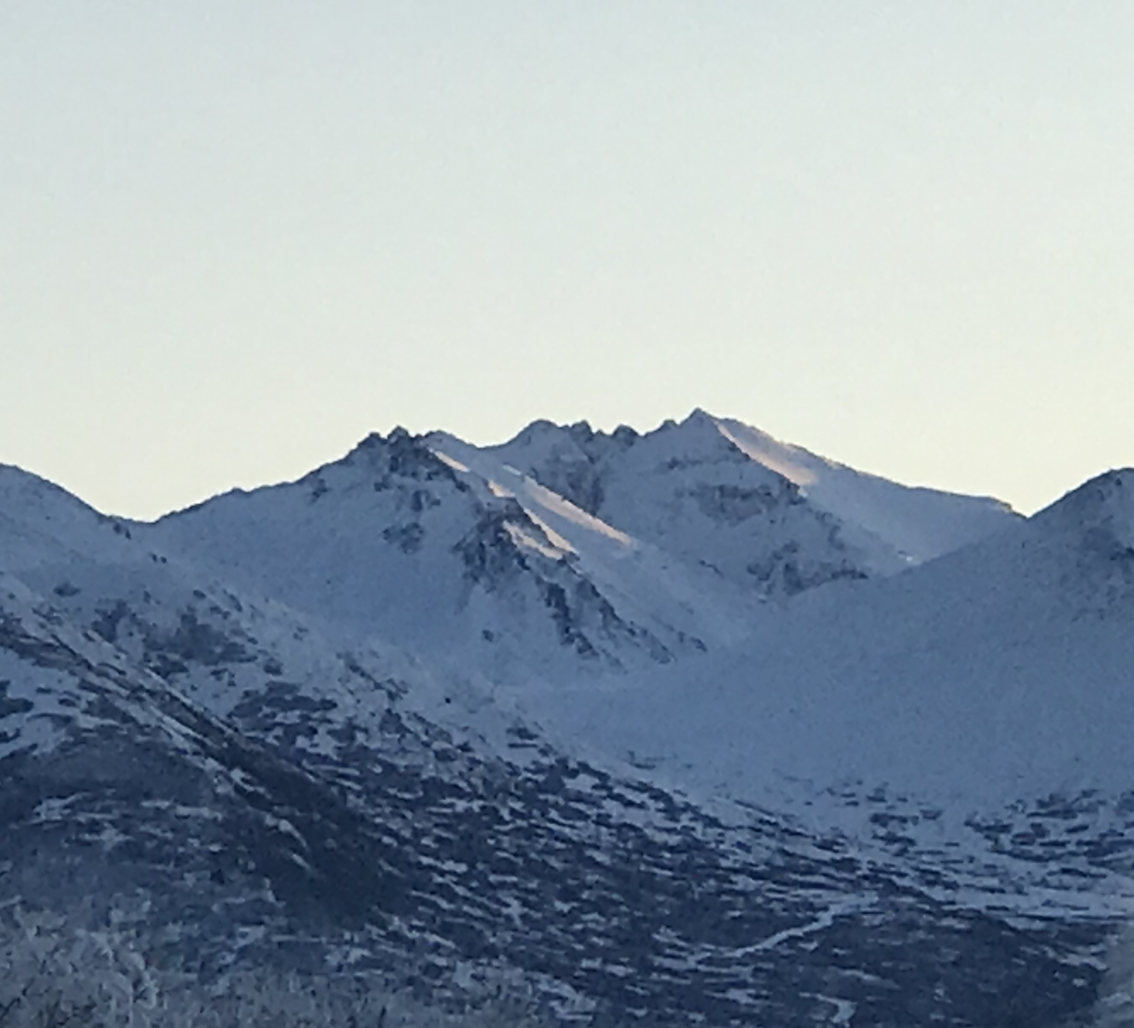
WELCOME from
Michèle,
your
teacher!

Slide 5
Housekeeping
https://unsplash.com/@othentikisra
Keep your microphone on mute, unless talking.
Bring paper and a pen or pencil.
Asking questions: Write your question in the chat box or raise your hand.
One of our volunteers will read the questions in the chat box and tell them to me.

Slide 6
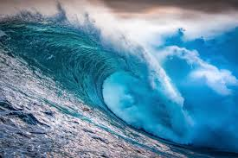
Housekeeping
Breakout Rooms: We’ll send you and bring you back.
If you accidentally leave Zoom, use the class link to rejoin!!

Slide 7
Welcome Each Other!!
Photo by Chang Duong on Unsplash

Slide 8
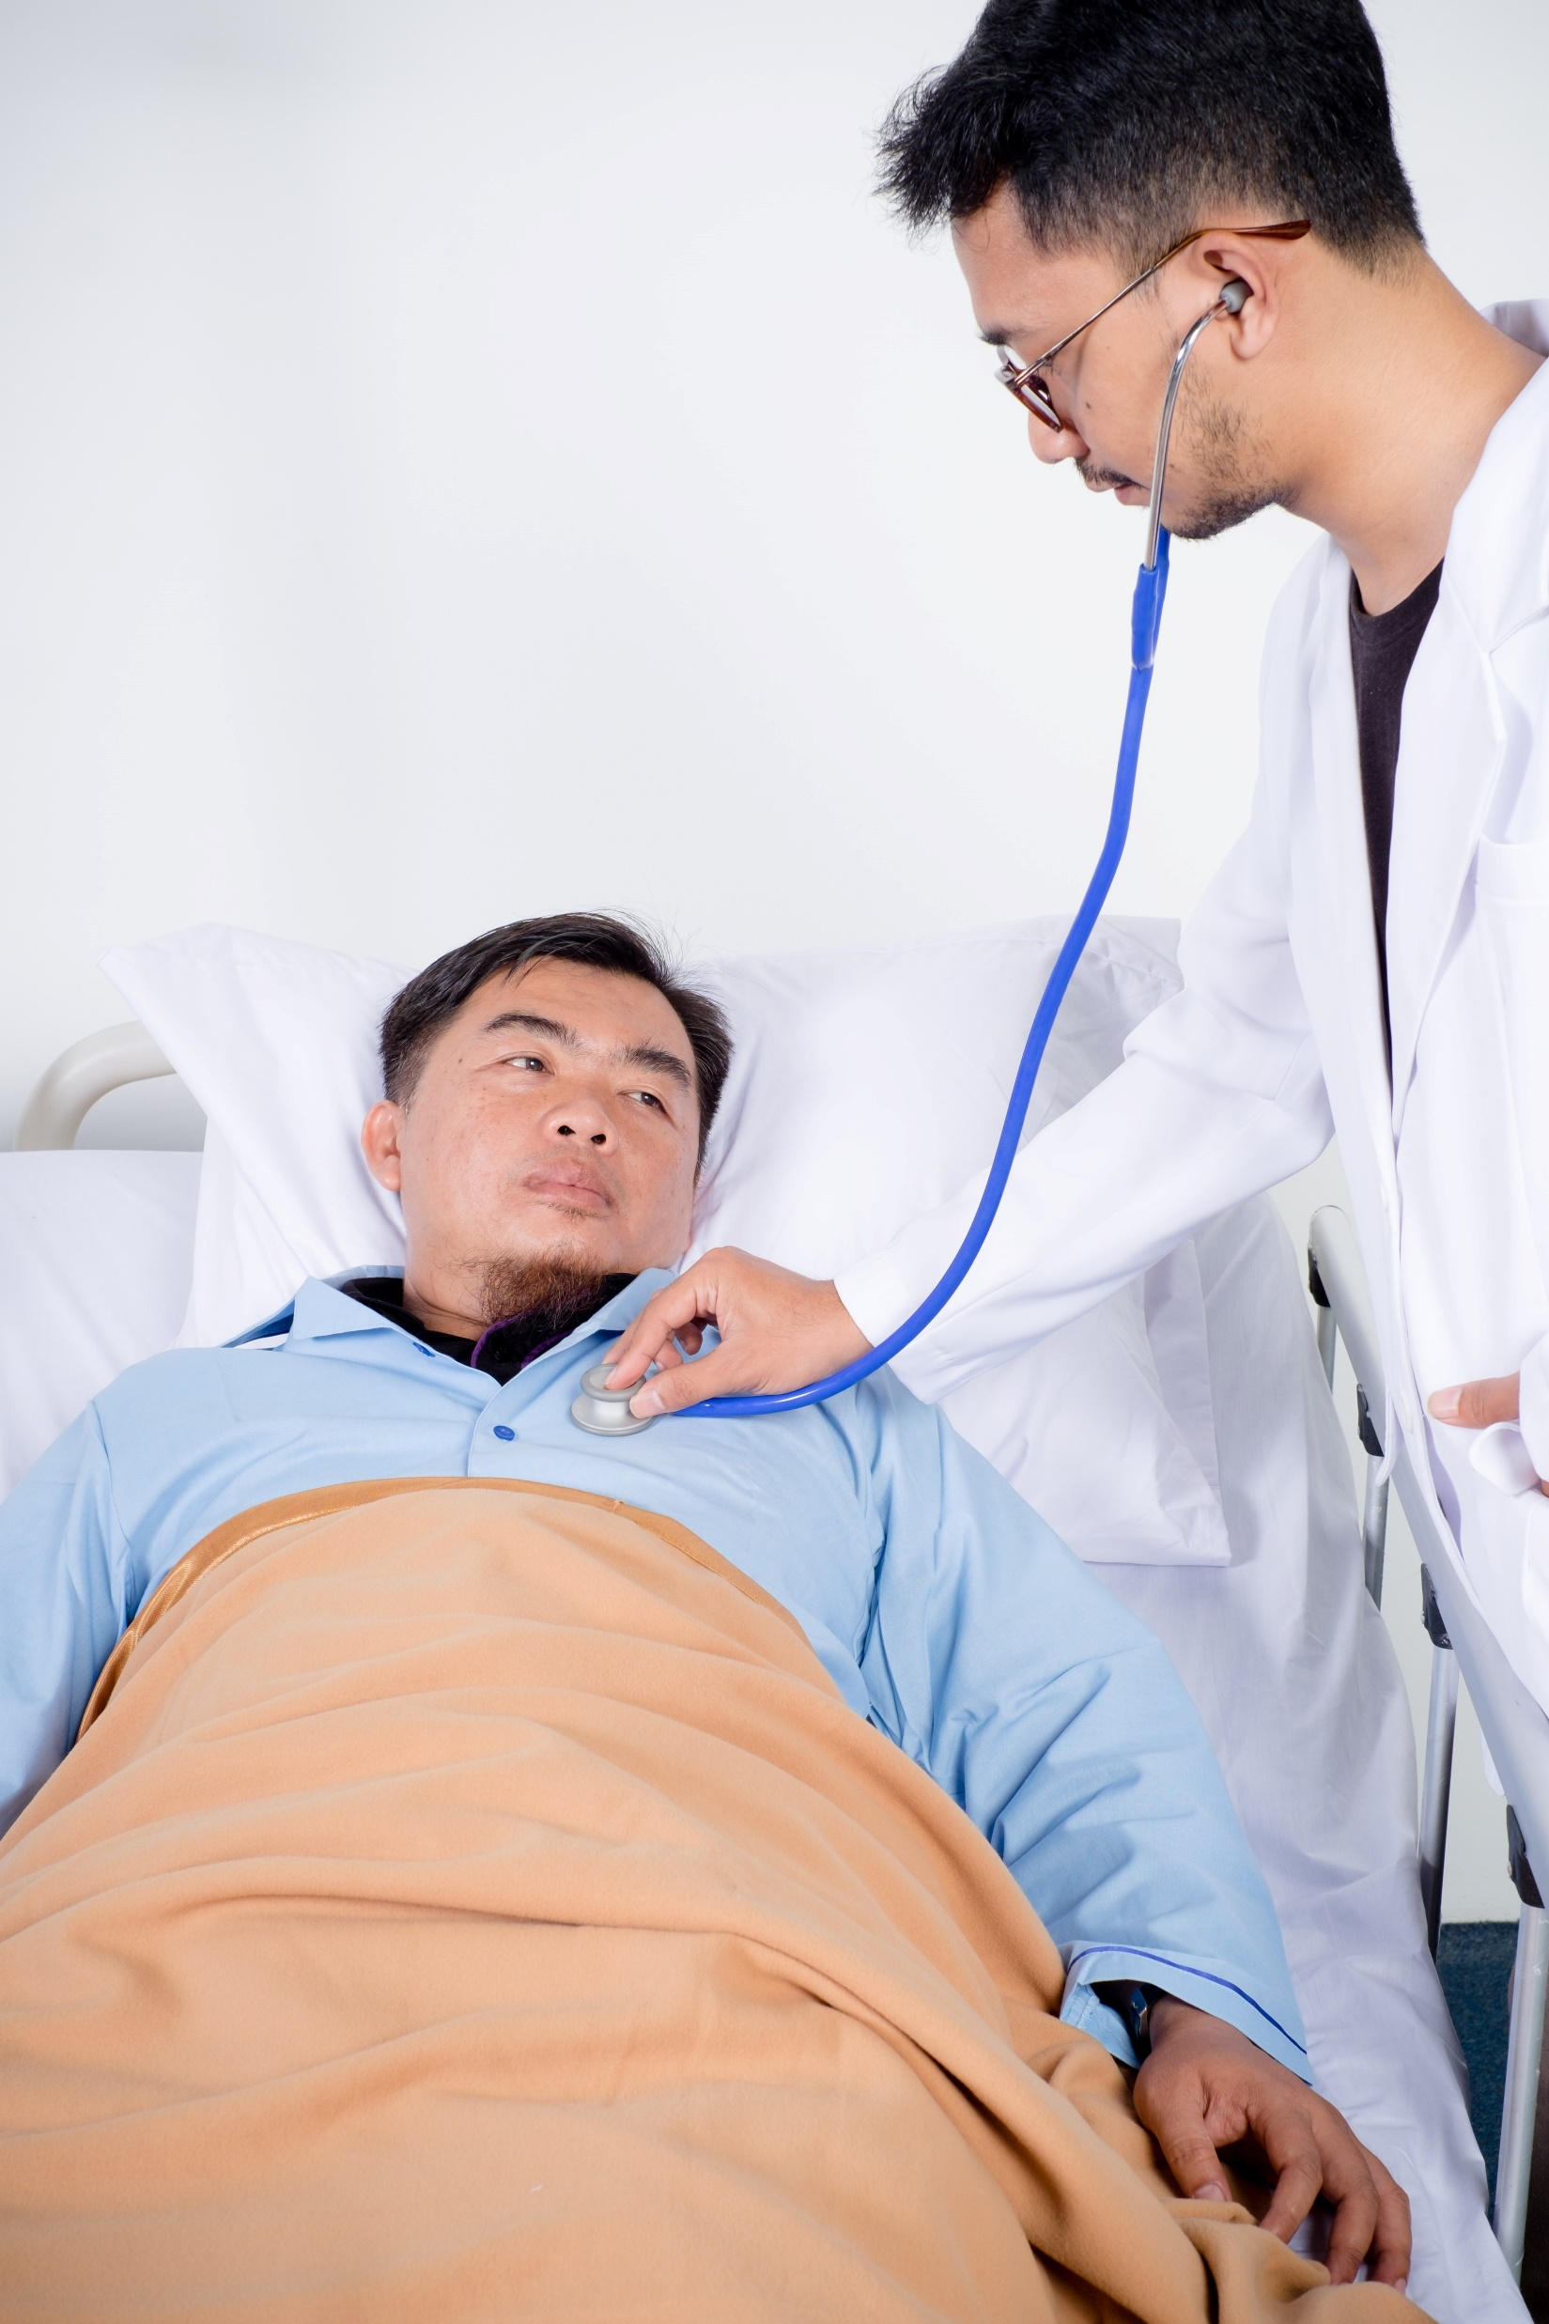
“My name is ______. I have _______.”
a cold a backache
an earache a runny nose
a fever a stomachache
a headache a cough
a sore throat a broken leg
a cut a toothache
https://unsplash.com/@ayahya09

Slide 9
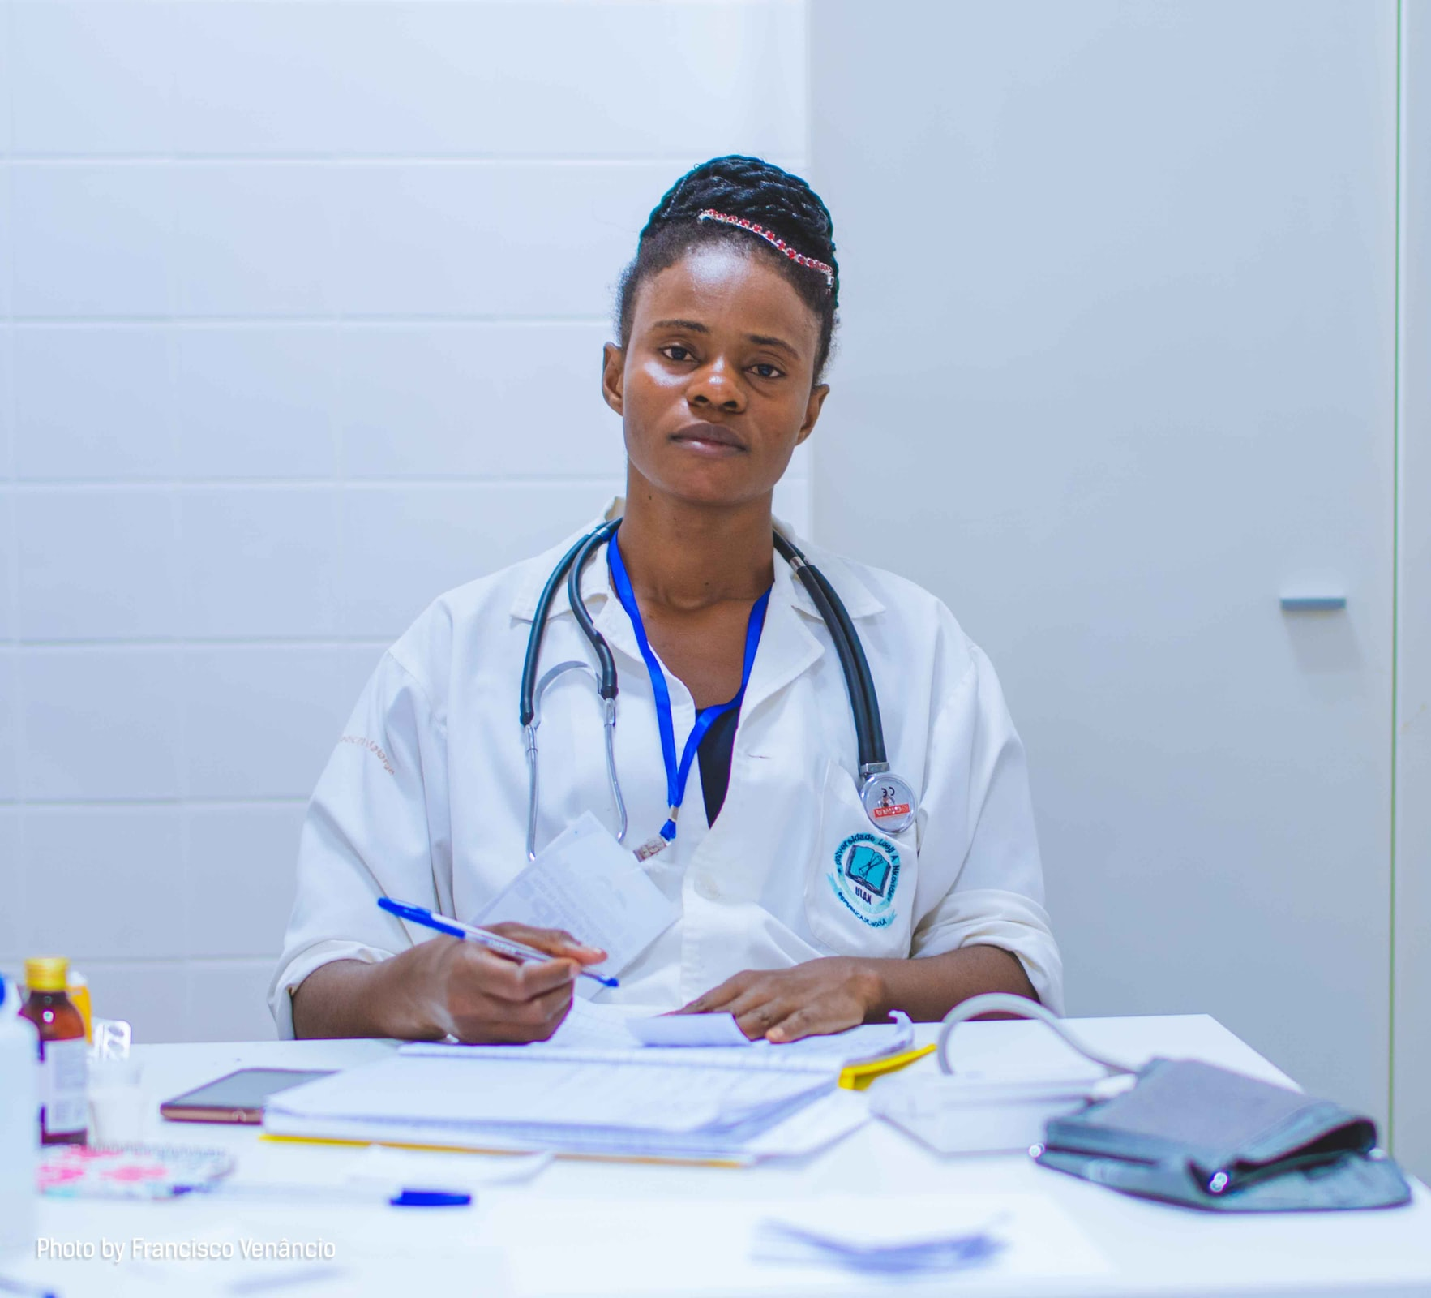
Unit Topic
Accessing Healthcare
(going to the doctor)
https://unsplash.com/photos/M4Xloxsg0Gw

Slide 10
What are we doing today? (Agenda)
…making an appointment
…learning to make polite requests
https://www.publicservicedegrees.org/resources/esl-ell-student-parent-teacher-resources/

Slide 11
What’s Your Viewpoint?
TAKE A PHOTO OF THIS SLIDE!!
In your home country, what was it like to go
to the doctor?
How is going to the doctor in America different from going to the doctor in your home country?
Is it easy for you to talk with your doctor in America?
In Chat:
Copy and paste these questions, please.

Slide 12
Breakout Rooms – 10 minutes
https://www.istockphoto.com/photos/ocean-waves?mediatype=photography&phrase=ocean%20waves&sort=mostpopular

Slide 13
Share Your Viewpoint!
CLASS
DISCUSSION
In your home country, what was it like to go
to the doctor?
How is going to the doctor in America different from going to the doctor in your home country?
Is it easy for you to talk with your doctor in America?

Slide 14
Asking Politely (Pragmatics)
Would instead of want:
Would you like to come on Tuesday?
Could instead of can:
Yes, could you see what times are available?

Slide 15
Asking Politely (Pragmatics)
Looking Ahead: As we listen to a video and practice a dialogue, listen for “would” and “could.”

Slide 16
Making an Appointment – Intro
Why should you make an appointment with the doctor?
The doctor will know that you need to see him/her.
It reserves a time for you to see the doctor.
What else can you think of?
https://www.rocketmatter.com/legal-billing/rocket-matter-adds-integration-with-ruby-receptionists/

Slide 17
Making an Appointment – Video
https://www.rocketmatter.com/legal-billing/rocket-matter-adds-integration-with-ruby-receptionists/
What do you think you will see in the video?
Who will be in it?
What will people be doing?

Slide 18
Making an Appointment - Video
https://www.rocketmatter.com/legal-billing/rocket-matter-adds-integration-with-ruby-receptionists/
Making an Appointment with the Doctor

Slide 19
Making an Appointment - Dialogue
https://www.rocketmatter.com/legal-billing/rocket-matter-adds-integration-with-ruby-receptionists/
Modeling the Dialogue:
Making a Doctor’s Appointment as a New Patient
…What are we going to do next?

Slide 20
Your Turn!
TAKE A PHOTO OF THIS SLIDE!!
https://www.rocketmatter.com/legal-billing/rocket-matter-adds-integration-with-ruby-receptionists/
Dialogue practice
Take turns playing the roles
Copy and paste the dialogue in Chat or
Download the document from chat, please.

Slide 21
Breakout Rooms – 10 minutes
https://www.istockphoto.com/photos/ocean-waves?mediatype=photography&phrase=ocean%20waves&sort=mostpopular

Slide 22
How did it go?
CLASS
DISCUSSION
https://www.rocketmatter.com/legal-billing/rocket-matter-adds-integration-with-ruby-receptionists/
What did you learn?
What should you do if you don’t understand what the doctor says to you?
Questions?

Slide 23
Review of Today’s Agenda
…making an appointment
…learning to make polite requests

Slide 24
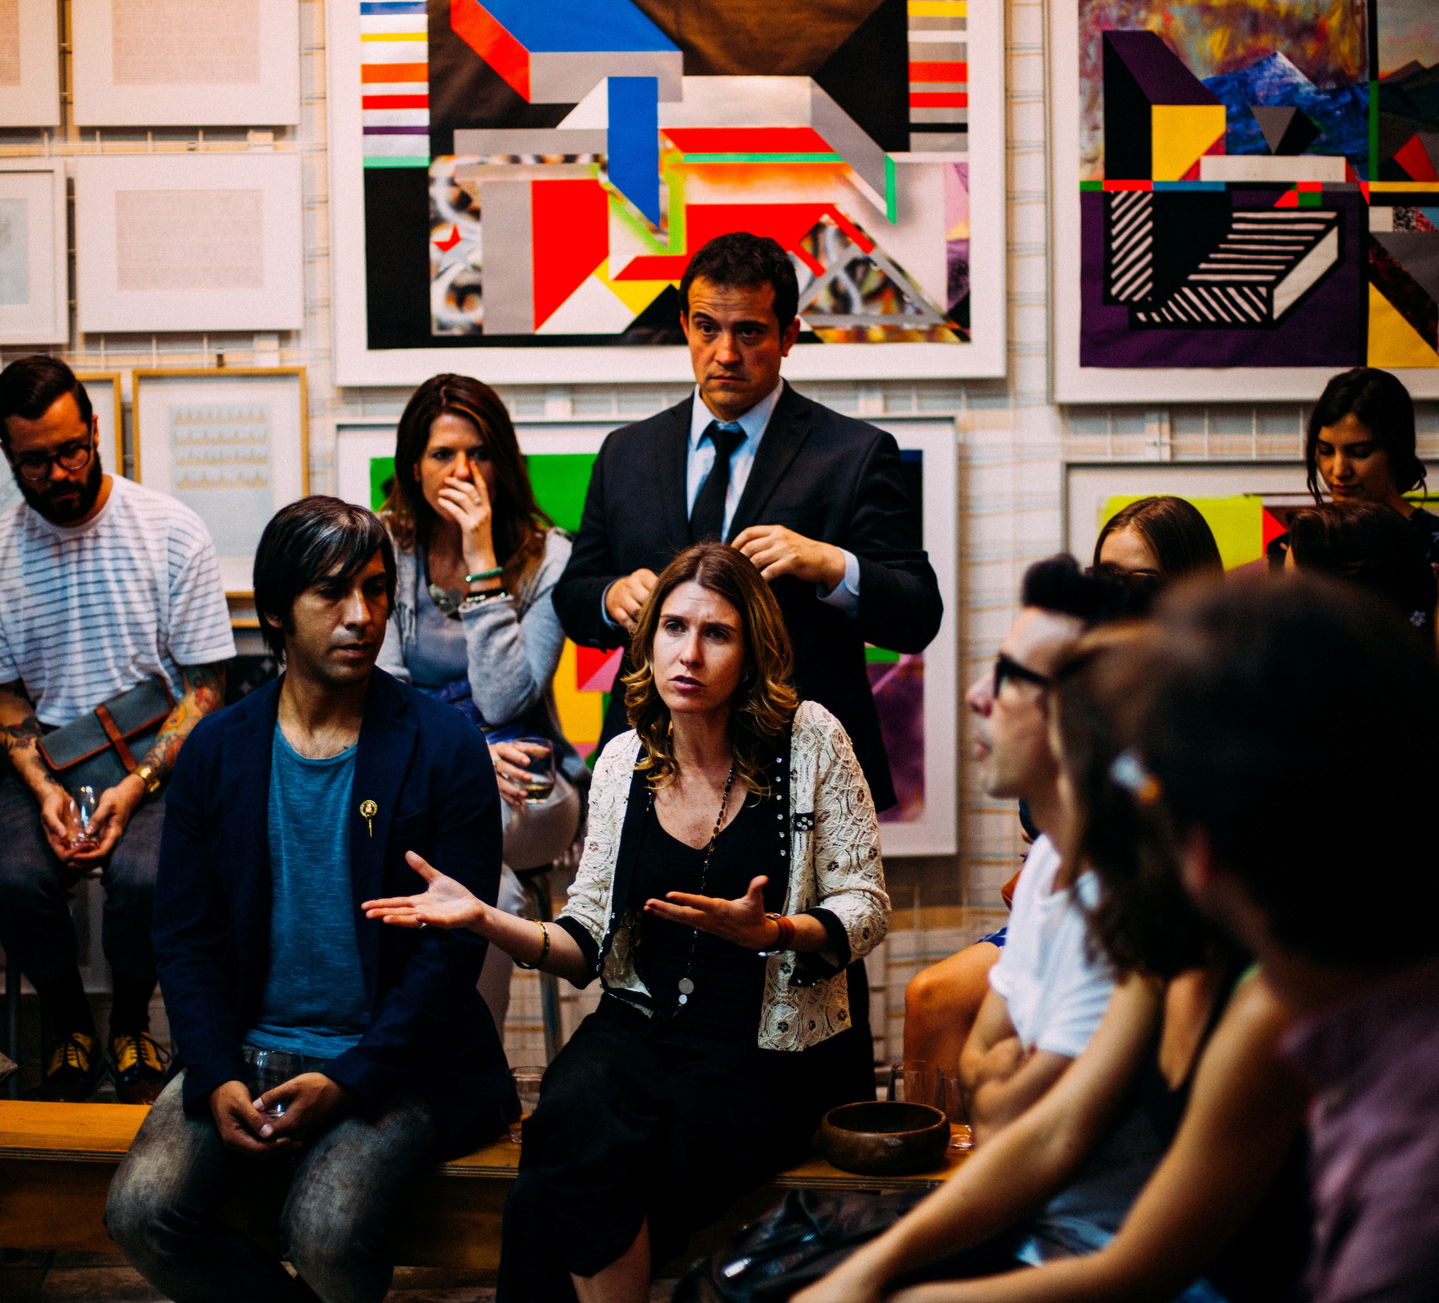
What did you learn?
Share
with
the
class!
https://unsplash.com/@antenna

Slide 25
Questions?
https://unsplash.com/@antenna

Slide 26
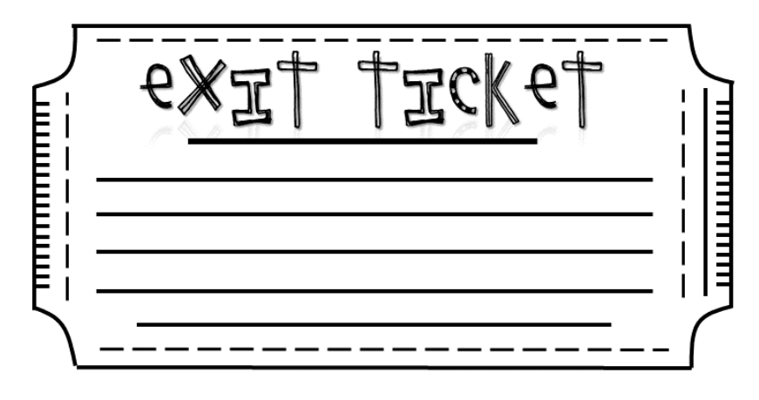
Please let us know...
something you learned today
anything you didn’t understand
Then, take a photo of your answers and send it to:
mpointel@zagmail.gonzaga.edu
Visit our GECO web site:
https://gecoenglish.weebly.com/
So glad you could come!
See you next week!

Slide 27
Thank you for coming!!!
https://www.dreamstime.com/illustration/goodbye.html

Slide 28
Have a Great Week!
https://www.istockphoto.com/photos/ocean-waves?mediatype=photography&phrase=ocean%20waves&sort=mostpopular

Slide 29
References
References
Beare, K.English for Medical Purposes - Making a Doctor's Appointment. YouTube. https://www.thoughtco.com/making-a-doctors-appointment-1210351
Merriam-Webster Learner's Dictionary. Merriam-Webster Learner’s
Dictionary. https://learnersdictionary.com/
Twominute English.At a hospital - Speak English words and phrases at a hospital. YouTube. https://youtu.be/twOLBbVvesU

Slide 30
Extension Activity
Have students write a dialogue between themselves (as a patient) and their doctor:
Patient: Identify a sickness.
Doctor and Patient: Discuss it.
Doctor: Respond with advice/direction.
Patient: Thank the doctor and leave. (See example next slide.)

Slide 31
Extension Activity - Example
Doctor: Hello, Mrs. Gomez.
Patient: Hello, Dr. Golden.
Doctor: How can I help you today?
Patient: I have a ________. I feel _______. I am _________.
Doctor: Tell me more.
Patient: Well, _________________.
Doctor: Ah! You have ________. Take 2 ____ and _____ me in ____ days.

