Slide 1
Welcome Week 2
GECO
Carely Villanueva, Gonzaga 2020

Slide 2
Introduce yourself

Slide 3
Introduce Yourself
What is your name?
Where are you from?
Where do you live?
What languages do you speak?
My name is ______________
I am from ______________
I live in ______________
I speak ______________

Slide 4
Find Someone Who …….

Slide 5
REJOINDERS

Slide 6
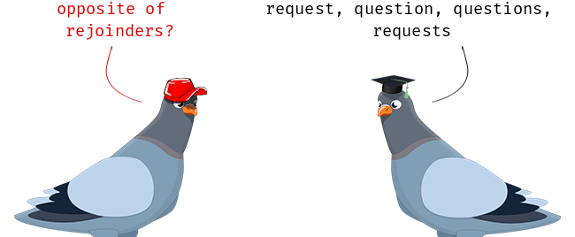
Rejoinders are expressions we use to react to what someone has said to show that we understand and sympathize with them.

Slide 7
Why do we need to use rejoinders?
I’m listening.
I understand.
I care. (Even if you don’t care, you should use them to be polite.)

Slide 8
If someone says something happy or good:
Really? 🙂 (This is happy only with the correct tone.)
That’s great! 😃
Nice! 🤗
Cool! 😎
That’s awesome! 🤩

Slide 9
If someone says something sad or bad
That’s too bad. 😞 (This is used more when something is disappointing or not good.)
(I’m) Sorry to hear that. 🙁😥 (This is used to express care and used for deaths and other sad situations.)
That’s terrible. 😠😫 (This is used when something very bad or serious happens.)
Oh, no! 😱😨 (This has an element of surprise, but it is a negative misfortune.

Slide 10
If someone says something surprising
Really?! 😮 (This is surprising only with the correct tone.)
Wait…What?! 😳 🤔 (This is very common in TV shows these days and can also express confusion.)
Seriously?! 🤨
Are you serious? 🤨
For real?! 😮
No way! 😲
Get out! 😲
Wow! 😲😀 (This is used for happy surprises, but with a different tone, it could be a shocking or disappointing surprise.)

Slide 11
If someone says something neutral (not good, not bad, not surprising)
I see. (Basically, you are saying I understand.)
Oh, yeah? (This expresses a bit more interest than I see.)
Interesting. (The level of interest will vary with the tone used.)
That’s nice. (This also varies but can be used when something has a positive element.)

Slide 12
Activity 1 Listen carefully. What type of rejoinders did you find?
https://www.youtube.com/watch?v=OpWj8-FMkPY
https://www.youtube.com/watch?v=jOQ58NZOIfQ

Slide 13
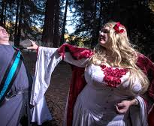
Activity 2 Role play
Create a dialogue using the vocabulary that you already learned, yes or no questions, and rejoinders. (10 minutes in the breakrooms).

Slide 14
Questions

Slide 15
Extension

